Slide 1



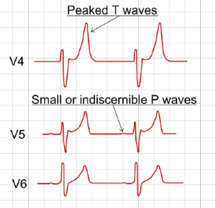








Common Scenario
Click these buttons to REVEAL & HIDE answers and graphics
Obtain STAT EKG
Hyperkalemia can cause life-threatening arrhythmias
sinus bradycardia, sinus arrest, asystole, V-tach, V-fib
Any K > 5.5 warrants EKG. Treat K > 6.5 as emergent regardless of EKG changes¹
Repeat EKG every 30-60 minutes to ensure resolution of EKG abnormalities
You are on a hospital wards rotation pre-rounding for the day when you get a call from the nurse for Mrs. Smith…
Nurse: “I have a critical lab to report on Mrs. Smith”
You: “What is the critical lab?”
Nurse: “The patient’s potassium is 6.7…”
Question: What do you do next?
Inpatient Management of Hyperkalemia
Inpatient Management of Hyperkalemia
Step 1
Myocardial Membrane Stabilization
Achieved by delivery of Calcium Salts
Step 2
Step 3
Step 4
Step 5
Cases

Slide 2
Common Scenario
Obtain STAT EKG
Hyperkalemia can cause life-threatening arrhythmias
sinus bradycardia, sinus arrest, asystole, V-tach, V-fib
Any K > 5.5 warrants EKG. Treat K > 6.5 as emergent regardless of EKG changes¹
Repeat EKG every 30-60 minutes to ensure resolution of EKG abnormalities
You are on a hospital wards rotation pre-rounding for the day when you get a call from the nurse for Mrs. Smith…
Nurse: “I have a critical lab to report on Mrs. Smith”
You: “What is the critical lab?”
Nurse: “The patient’s potassium is 6.7…”
Question: What do you do next?
Inpatient Management of Hyperkalemia
Step 1
Myocardial Membrane Stabilization
Achieved by delivery of Calcium Salts
Step 2
Step 3
Step 4
Step 5
Cases
Notes:
added the word ‘lab’ to the ‘You’ quote on common scenario
For potassium excretion table
Remove ‘risk of bowel necrosis’ and ‘no benefit over other laxatives’ to make space for:
“Don’t give if HD is expected. Diarrhea is difficult to manage during HD”. Or something like that. At least at UW, this was the most common reason nephro asked us not to give it.
3. Final framework. Do you want to have a summary slide that lists it out 1. consider recheck, 2. myocardial stabilization - CaCl 1g IV CVC or Ca Gluconate 2g IV PIV, 3. shift: 10u insulin + D50, albuterol, NaHCO3 50meq IV, 4. excretion – NaCl or NaHCO3, Lasix (if retained renal function and not hypovolemic), kayexalate (unless HD is planned). Or something like that.
3. I added the other cases template slide in case you prefer the layout. Either are fine. The one you had might be nice because of the extra room for ECGs. But I think you should plan on more than 2 cases.

Slide 3
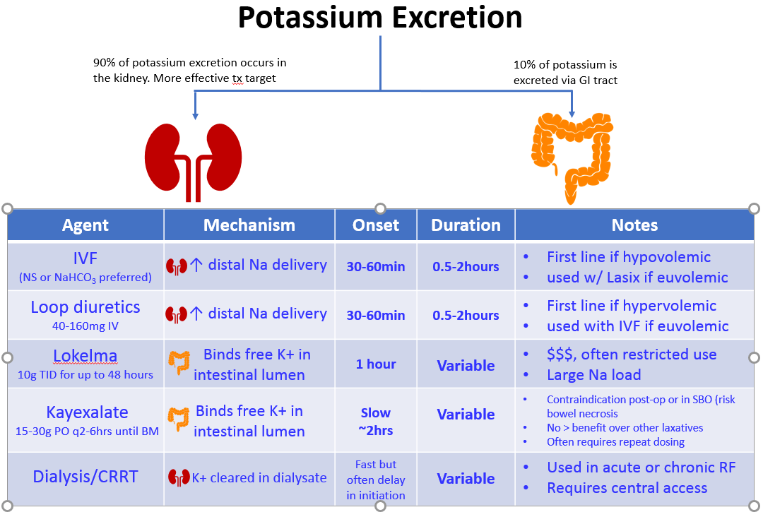

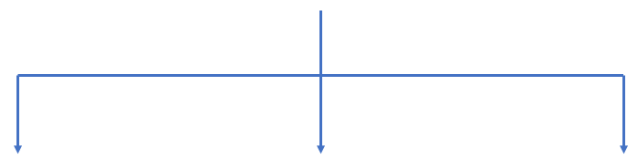



Common Scenario
Click these buttons to REVEAL & HIDE answers and graphics
K > 5.5?
Considerations
Obtain STAT EKG
Hyperkalemia can cause life-threatening arrhythmias
sinus bradycardia, sinus arrest, asystole, V-tach, V-fib
Any K > 5.5 warrants EKG. Treat K > 6.5 as emergent regardless of EKG changes¹
Repeat EKG every 30-60 minutes to ensure resolution of EKG abnormalities
Potassium Shifting
You are on a hospital wards rotation pre-rounding for the day when you get a call from the nurse for Mrs. Smith…
Nurse: “I have a critical lab to report on Mrs. Smith”
You: “What is the critical lab?”
Nurse: “The patient’s potassium is 6.7…”
Question: What do you do next?
Inpatient Management of Hyperkalemia
Step 1
Confirm hyperK
Myocardial Membrane Stabilization
Achieved by delivery of Calcium Salts
Click again to hide graphic
Hyperkalemia leads to characteristic EKG changes:
Early Changes:
Peaked T-waves
QT shortening
As Hyperkalemia Worsens:
QRS prolongs
PR prolongs
P wave may disappear
Step 2
Agent: | Calcium Chloride 0.5-1g IV (More potent, requires central access) | Calcium Gluconate 1-2g IV (Can be given peripherally)
Onset: | 3-5 minutes
Duration: | 30-60 minutes
Effect: | No effect on K+ levels. Should Normalize EKG. If not, re-dose.
Source: The Hospitalist Handbook UCSF Department of Medicine (Vol. Acid-Base/Electrolytes).
Is this result unexpected?
Is there hemolysis?
Step 3
Insulin + D50
(10u* Regular Insulin +1amp D50)
*lower insulin dose if renal impairment
Onset: 15-60 minutes
Duration: 4-6 hours (longer if AKI)
Lowers Serum K ~0.5-1.0meq
β2-agonism
Albuterol 10-20mg in 4mL saline
Higher than asthma/COPD dosing (2.5mg)
Onset: 15-30 minutes
Duration: 2-4 hours
Lowers Serum K 0.5-1.5meq
NaHCO₃
For Non-ESRD w/ acidosis only
Give 50-100meq IV
Onset: 15-30minutes
Duration: 1-2 hours
Least effective shifting strategy
+
+
Step 4
Step 5
Note: Shifting is a temporizing measure to buy time for more definitive management
The shifting strategy is usually chosen based on the patient’s comorbid conditions
Cases
Repeat potassium

Slide 4

Common Scenario
Click these buttons to REVEAL & HIDE answers and graphics
K > 5.5?
Obtain STAT ECG
Step 1
Confirm hyperK
Myocardial Membrane Stabilization
Achieved by delivery of Calcium Salts
Click again to hide graphic
Hyperkalemia can cause life-threatening arrhythmias
(e.g., sinus bradycardia, sinus arrest, asystole, VT/VF)
Stat ECG
Step 2
Obtain ECG for any K > 5.5
Agent: | Calcium Chloride 0.5-1g IV (More potent, requires central access) | Calcium Gluconate 1-2g IV (Can be given peripherally)
Onset: | 3-5 minutes
Duration: | 30-60 minutes
Effect: | No effect on K+ levels. Should Normalize EKG. If not, re-dose.
Source: The Hospitalist Handbook UCSF Department of Medicine (Vol. Acid-Base/Electrolytes).
Step 3
Look for characteristic, progressive ECG changes
Step 4
Peaked T waves
QT shortening
PR prolongation
QRS widening
Loss of P waves
QRS widens further
Step 5
Cases
Repeat ECG every 30 – 60 min to ensure resolution of abnormalities
Monitor on telemetry

Slide 5
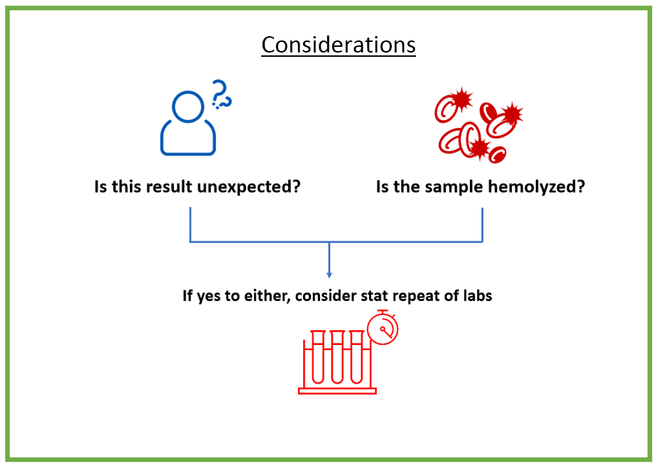

Common Scenario
Click these buttons to REVEAL & HIDE answers and graphics
K > 5.5?
Cardiac Membrane Stabilization
Obtain STAT EKG
Hyperkalemia can cause life-threatening arrhythmias
sinus bradycardia, sinus arrest, asystole, V-tach, V-fib
Any K > 5.5 warrants EKG. Treat K > 6.5 as emergent regardless of EKG changes¹
Repeat EKG every 30-60 minutes to ensure resolution of EKG abnormalities
Potassium Shifting
You are on a hospital wards rotation pre-rounding for the day when you get a call from the nurse for Mrs. Smith…
Nurse: “I have a critical lab to report on Mrs. Smith”
You: “What is the critical lab?”
Nurse: “The patient’s potassium is 6.7…”
Question: What do you do next?
Inpatient Management of Hyperkalemia
Step 1
Confirm hyperK
Click again to hide graphic
Hyperkalemia leads to characteristic EKG changes:
Early Changes:
Peaked T-waves
QT shortening
As Hyperkalemia Worsens:
QRS prolongs
PR prolongs
P wave may disappear
Stat ECG
ECG changes or K > 6.5
Step 2
ECG Δ / K> 6.5
Calcium Chloride 0.5-1 g IV | Calcium Gluconate 1-2 g IV
More potent, requires central access | Can be given peripherally
Onset: 3-5 minutes
Duration: 30-60 minutes
No effect on K+ levels but should normalize ECG changes
IV Ca
f/u ECG
Step 3
Insulin + D50
(10u* Regular Insulin +1amp D50)
*lower insulin dose if renal impairment
Onset: 15-60 minutes
Duration: 4-6 hours (longer if AKI)
Lowers Serum K ~0.5-1.0meq
β2-agonism
Albuterol 10-20mg in 4mL saline
Higher than asthma/COPD dosing (2.5mg)
Onset: 15-30 minutes
Duration: 2-4 hours
Lowers Serum K 0.5-1.5meq
NaHCO₃
For Non-ESRD w/ acidosis only
Give 50-100meq IV
Onset: 15-30minutes
Duration: 1-2 hours
Least effective shifting strategy
Step 4
Step 5
Repeat ECG
Note: Shifting is a temporizing measure to buy time for more definitive management
The shifting strategy is usually chosen based on the patient’s comorbid conditions
Cases
Redose IV Ca every 5-10 min if persistent ECG changes

Slide 6

Common Scenario
Click these buttons to REVEAL & HIDE answers and graphics
K > 5.5?
Obtain STAT EKG
Hyperkalemia can cause life-threatening arrhythmias
sinus bradycardia, sinus arrest, asystole, V-tach, V-fib
Any K > 5.5 warrants EKG. Treat K > 6.5 as emergent regardless of EKG changes¹
Repeat EKG every 30-60 minutes to ensure resolution of EKG abnormalities
Potassium Shifting
You are on a hospital wards rotation pre-rounding for the day when you get a call from the nurse for Mrs. Smith…
Nurse: “I have a critical lab to report on Mrs. Smith”
You: “What is the critical lab?”
Nurse: “The patient’s potassium is 6.7…”
Question: What do you do next?
Inpatient Management of Hyperkalemia
Step 1
Confirm hyperK
Myocardial Membrane Stabilization
Achieved by delivery of Calcium Salts
Click again to hide graphic
Hyperkalemia leads to characteristic EKG changes:
Early Changes:
Peaked T-waves
QT shortening
As Hyperkalemia Worsens:
QRS prolongs
PR prolongs
P wave may disappear
Shifting K intracellularly is a temporizing measure to buy time for more definitive management
Stat ECG
Step 2
ECG Δ / K> 6.5
Insulin + D50
Insulin + D50
B2 agonists
Na HCO₃
B2 agonists
Na HCO₃
Agent: | Calcium Chloride 0.5-1g IV (More potent, requires central access) | Calcium Gluconate 1-2g IV (Can be given peripherally)
Onset: | 3-5 minutes
Duration: | 30-60 minutes
Effect: | No effect on K+ levels. Should Normalize EKG. If not, re-dose.
Source: The Hospitalist Handbook UCSF Department of Medicine (Vol. Acid-Base/Electrolytes).
IV Ca
f/u ECG
IV 10U* Regular Insulin + 1 amp D50
*IV 5U Regular insulin if renal impairment
↓ K ~0.5-1.0 mEq
Albuterol 10-20mg in 4mL saline
Higher than asthma/COPD dosing (2.5mg)
↓ K 0.5-1.5 mEq
50-100 mEq IV
For non-ESRD with acidosis only
Least effective shifting strategy
Step 3
Insulin+D50W
Albuterol
±NaHCO3
Step 4
Step 5
1 h
2 h
3 h
4 h
5 h
6 h
Insulin + D50
If AKI
Albuterol
Cases
HCO3

Slide 7
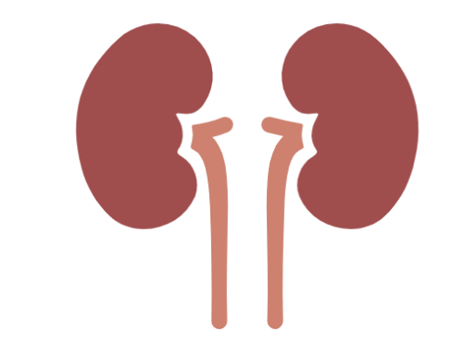


Common Scenario
Potassium Elimination
K > 5.5?
Step 1
Confirm hyperK
90%
10%
Stat ECG
Step 2
ECG Δ / K> 6.5
↑distal Na delivery
K cleared in dialysate
Bind free K+ in gut
IV Ca
f/u ECG
Step 3
Lokelma
Kayexalate
HD/ CRRT
Lokelma
Kayexalate
IVF
Loop diuretic
HD/ CRRT
IVF
Loop diuretic
Insulin+D50W
Albuterol
±NaHCO3
1st line if ↓V
+ loops if euvolemic
IV 40-160 mg
1st line if ↑V
+ IVF if euvolemic
Used in acute or chronic renal failure
$$$
Large Na load
Limited
Risk of bowel necrosis (SBO, post-op)
Step 4
IVF ± loops
HD
Lokelma
Kayexalate
Step 5
30 min
1 h
2 h
3 h
4 h
5 h
6 h
12 h
24 h
48 h
NS, NaHCO₃
Loops
Cases
HD/CRRT
Repeat K in 1-4 h
Lokelma 10 g TID
Kayexalate 15-60 g q6h

Slide 8


Common Scenario
Case 1
Case 2
55 yo with ESRD on HD via an AV fistula presents with shortness of breath and pain in their fistula site after missing dialysis. Fistulogram shows stenosis of the AV fistula. They are anuric.
BMP - K 6.7 (no hemolysis), HCO3 19, BUN 56, Cr of 10.5.
65 yo with metastatic colon cancer presents for colectomy. On POD3, develops new non-oliguric AKI.
Appears euvolemic on exam. Labs show K of 6.0, Cr 0.6 → 3.5, HCO3 13. ABG shows pH of 7.2.
Step 1
Step 2
What is the next step in management?
What is the next step in management?
Obtain an ECG. Click below for full image.
Obtain an ECG.
Step 3
Step 4
What is the next step in management?
What is the next step in management?
ECG – no obvious changes. With the severity of hyperkalemia, give IV Ca (gluconate 1- 2 g) for cardiac stabilization. Monitor on telemetry.
IV Ca gluconate 1-2 g. Repeat ECG in 30-60 min. Repeat IV Ca if persistent ECG changes. Monitor on telemetry.
Step 5
What temporizing measures would you use?
What temporizing measures would you use?
IV regular insulin 5U (because of ESRD) + D50W, albuterol nebulizer 20 mg. NaHCO₃ likely ineffective in ESRD.
IV regular insulin 5U (because of AKI) + D50W, albuterol nebulizer, NaHCO₃ given acidosis
Cases
What medications will you use for K elimination?
What medications will you use for K elimination?
SZC if available, Kayexalate and urgent reversal of fistulogram. Loop diuretics are ineffective when anuria.
IV loop diuretics +/- IVF (isotonic NaHCO₃ infusion) to avoid worsening Cr. No Kayexalate given recent bowel surgery

Slide 9
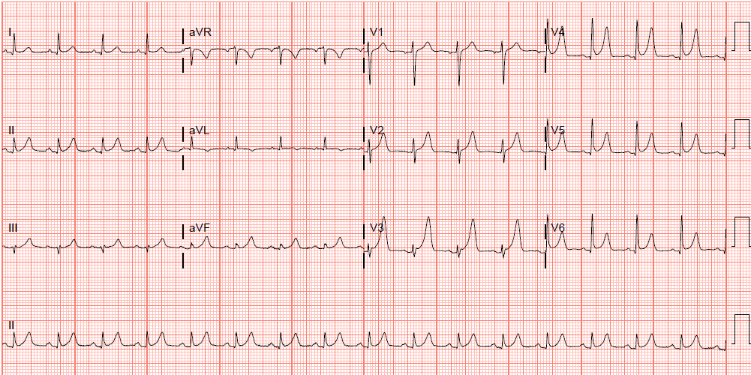
BACK
Diffusely peaked T waves
ECG read

Slide 10
Guideline Update: UKKA 2023 & KDIGO 2024 (original teaching unchanged)
UK Kidney Association — Management of Hyperkalaemia in Adults (Oct 2023)
Emergency thresholds match this talk: IV calcium for ECG changes; treat K≥ 6.5 mmol/L as an emergency.
Insulin–glucose + nebulized β2-agonist remain first-line shifting; monitor glucose ≥ 6 h after insulin (hypoglycemia is the most common complication).
NEW: sodium zirconium cyclosilicate (SZC/Lokelma) 10 g TID up to 72 h is now an option ALONGSIDE shifting agents in acute life-threatening hyperkalemia (K ≥ 6.5).
Sodium polystyrene sulfonate (Kayexalate) is NOT recommended for emergency treatment — reserve for non-urgent settings when SZC/patiromer unavailable.
KDIGO 2024 CKD Guideline
RASi-associated hyperkalemia: lower the potassium (diuretics, binders, dietary review, bicarbonate if acidotic) rather than reflexively stopping the ACEi/ARB — RASi discontinuation is linked to higher mortality and CV events in CKD.
Sources: UKKA Clinical Practice Guideline, Management of Hyperkalaemia in Adults (2023); KDIGO 2024 CKD Guideline (Kidney Int 2024).

Slide 11
Take-Home Points
1. Hyperkalemic crisis is a medical emergency — severe weakness and fatal arrhythmias. Any K > 5.5 → STAT ECG; treat K > 6.5 as emergent regardless of ECG.
2. ECG changes: peaked T waves → P-wave loss → QRS widening → sine wave/VF. ECG changes or K > 6.5 → IV calcium gluconate 1–2 g (chloride 0.5–1 g via central line); re-dose in 5–10 min if ECG unchanged.
3. Shift K intracellularly while you arrange elimination: regular insulin 10U IV + D50 (5U if renal impairment), albuterol neb 10–20 mg, ± NaHCO3 (only if metabolic acidosis, not ESRD).
4. Eliminate K: loop diuretics ± isotonic fluids if volume allows; binders (SZC 10 g TID preferred over Kayexalate) if renal dysfunction; urgent dialysis for severe renal failure or refractory hyperkalemia.
5. Recheck K in 1–4 h and repeat ECG every 30–60 min until abnormalities resolve; shifting only buys time — it does not remove potassium.

Slide 12
Attribution & Changelog
Original
"Inpatient Management of Hyperkalemia" — TeachIM.org (Dec 2021). Authors: Tiffany Gardner MD, Caitlin Dietsche MD, Yilin Zhang MD. Exec. editor: Yilin Zhang MD. https://teachim.org/teaching_material/hyperkalemia-3/ — CC BY-NC 4.0 (educational, non-commercial use).
Corrections in this optimized copy (June 2026)
Slide 7: Lokelma "10 mg TID" → "10 g TID"; Kayexalate "15-60 mg q6h" → "15-60 g q6h" (unit errors; doses per lesson text & UKKA 2023).
Slide 8 Case 1: albuterol "nebulizer 20 g" → "20 mg" (unit error; deck slide 6 & lesson text say 10–20 mg).
Spelling: "Kayexelate" → "Kayexalate" (8×, slides 7–8).
Appended slides only — all original 9 slides, animations, and click-to-reveal builds preserved.
Companion files
Facilitator-guide-1.docx · hyperkalemia-worksheet.docx · Hyperkalemia_Lesson_Package.html · Hyperkalemia_OnePager.pdf · Hyperkalemia_Anki_Cards.txt

